Slide 1
MongoDB Exercises
1. Create Operation:
Create a new database named "library" and switch to it.
Create a collection named "books" with fields: title, author, and published_year.
Insert a document into the "books" collection with the details of your favorite book.

Slide 2
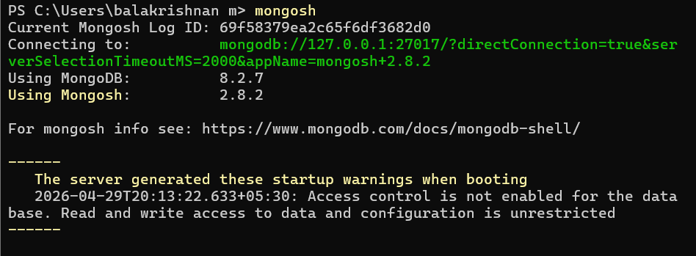
mongosh

Slide 3
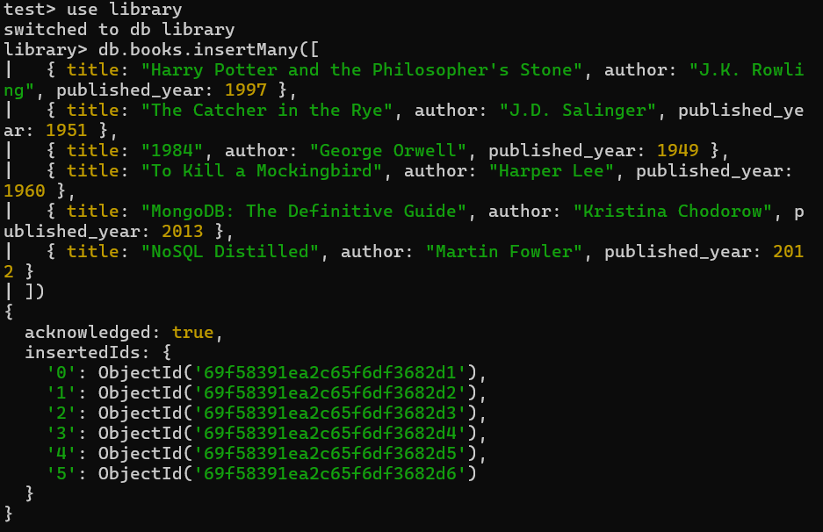
Create a new database named "library" and switch to it.
Create a collection named "books" with fields: title, author, and published_year.

Slide 4
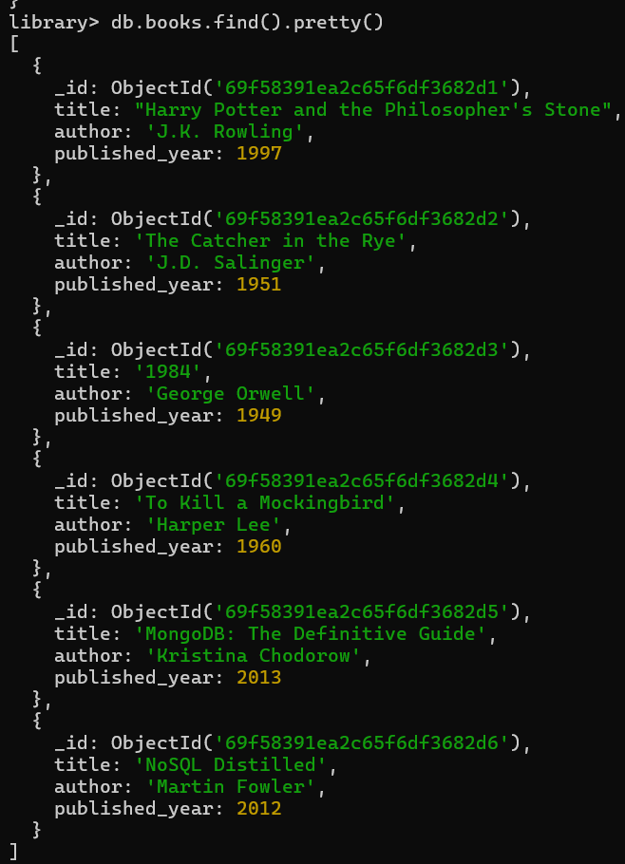
Retrieve all documents from the "books" collection.
- Find and display only the documents where the author is "J.K. Rowling".
- Fetch and display the document with the earliest published year.

Slide 5
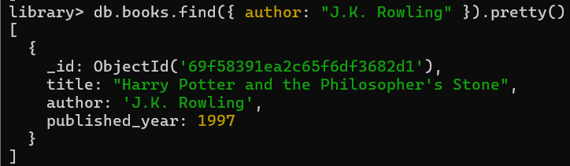
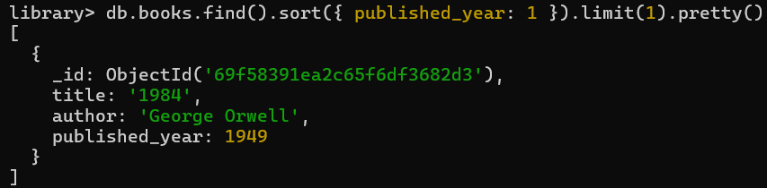
- Find and display only the documents where the author is "J.K. Rowling".
- Fetch and display the document with the earliest published year.

Slide 6
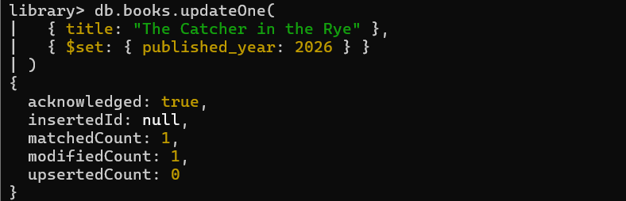
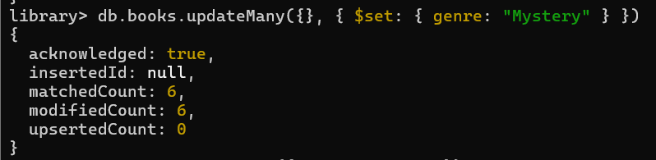
3. **Update Operation:**
- Update the published year of the book with the title "The Catcher in the Rye" to the current year.
- Add a new field "genre" with the value "Mystery" to all documents in the "books" collection.

Slide 7
4. **Delete Operation:**
- Remove the document with the title "1984" from the "books" collection.
- Delete all documents from the "books" collection where the published year is before 2000.

Slide 8
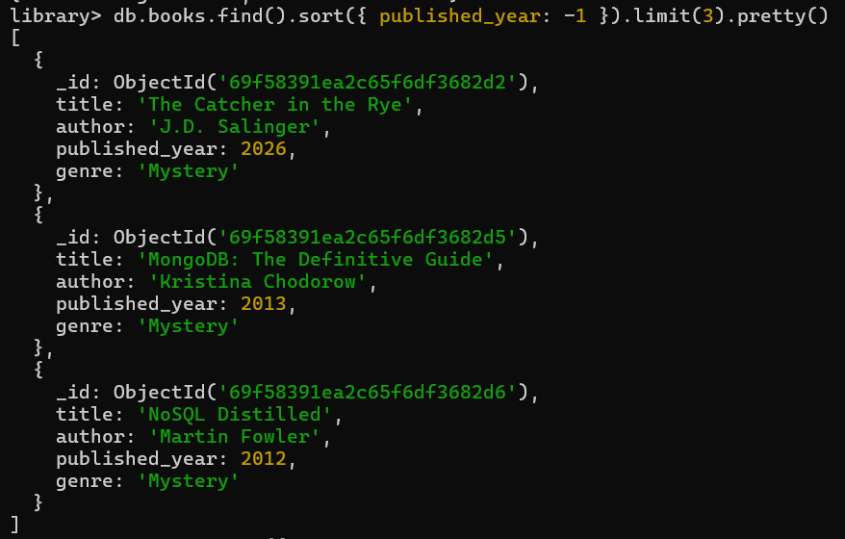
5. **Advanced Query:**
- Find and display the top 3 recently published books from the "books" collection.

Slide 9
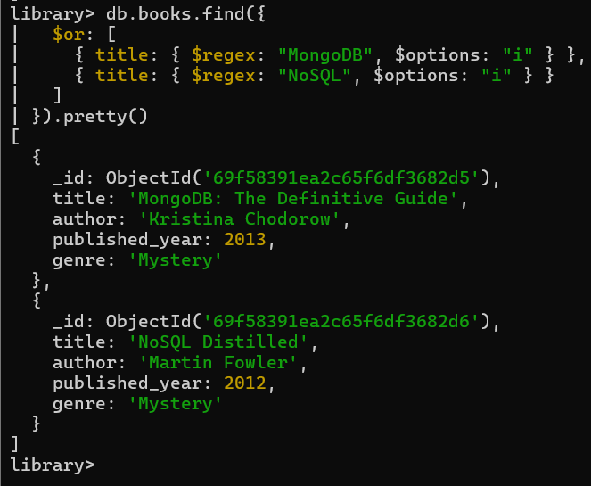
- Retrieve documents from the "books" collection where the title contains the word "MongoDB" or "NoSQL".

Slide 10
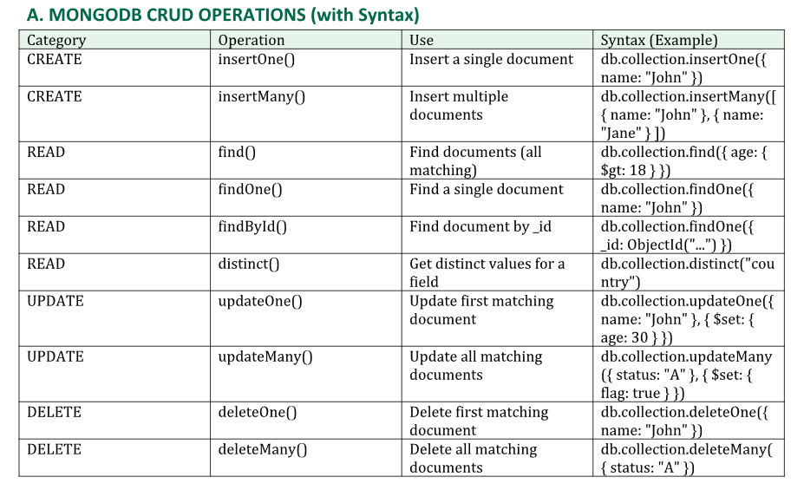

Slide 11
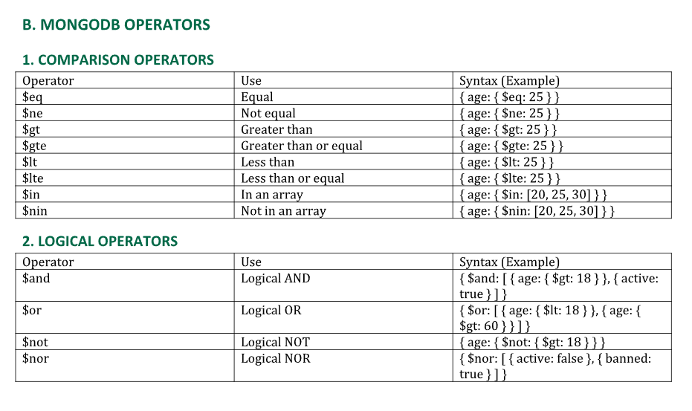

Slide 12
